Slide 1
NODE.JS
(The Backend Of MERN Stack)
Lecture 15

Slide 2
Today’s Agenda
What is a web server?
How to create a web server in Node ?
The http module
Creating web server using http module
Sending response
Important methods/properties of response object
Sending HTML
Sending JSON
Routing

Slide 3
What is a web server ?
When we view a webpage in our browser, we are making a request to another computer on the internet, which then provides us the webpage as a response.
That computer with which we are communicating via the internet is a web server.

Slide 4
What is a web server ?
So basically a web server is a computer that receives an HTTP requests from a client, like our browser, and provides an HTTP response, like an HTML page or JSON from an API.

Slide 5
How to create web server in node ?
There are mainly two ways to create a web server in Node:
Using a core module called http
Using a third party module called express

Slide 6
Using http module for creating web server
Node.js has a built-in module called http, which allows us to create an HTTP server that listens to server ports and gives a response back to the client.
With this we can easily create a backend service for our client applications.
Like a web application that we build with react or Angular, or a mobile application running on a mobile device.

Slide 7
Steps needed
To create a web server using http module we need to take 4 steps:
Import the http module
Call the function createServer() of http and receive the server object it returns
Using that server object create an event handler for “connection” event by calling the on() method.
Finally start the server and wait for the client request by calling the server object method listen() passing it the required port number

Slide 8
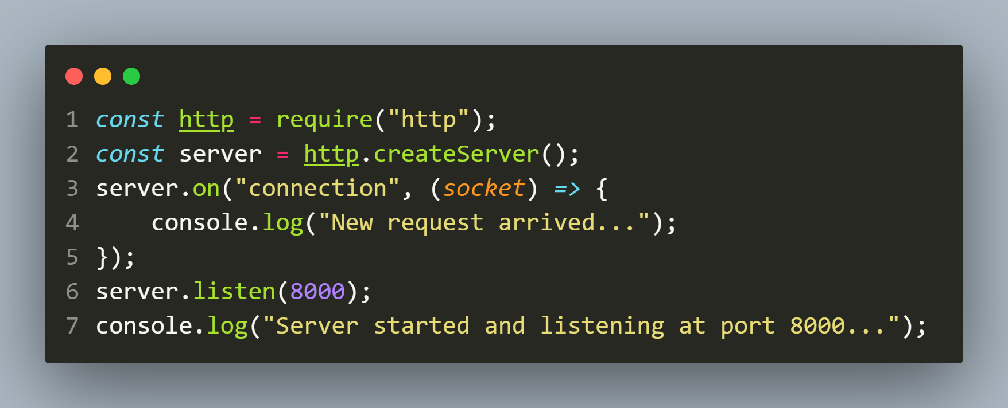

example
The code
The output

Slide 9
Sending request
Now open the browser and send the request to http://ocalhost:8000.
As soon as the request is sent , the “connection” event will execute and it’s handler will run to show the output:
New request arrived…

Slide 10
A better way
The connection event is a very low level event which deals with socket object .
So instead of handling requests in this way we can directly pass a callback function to createServer() function with 2 arguments : request and response.

Slide 11
A better way
This function is called every time the server receives a request from the client .
So , as soon as the request will be sent by the client , the callback function passed to createServer() will execute.

Slide 12
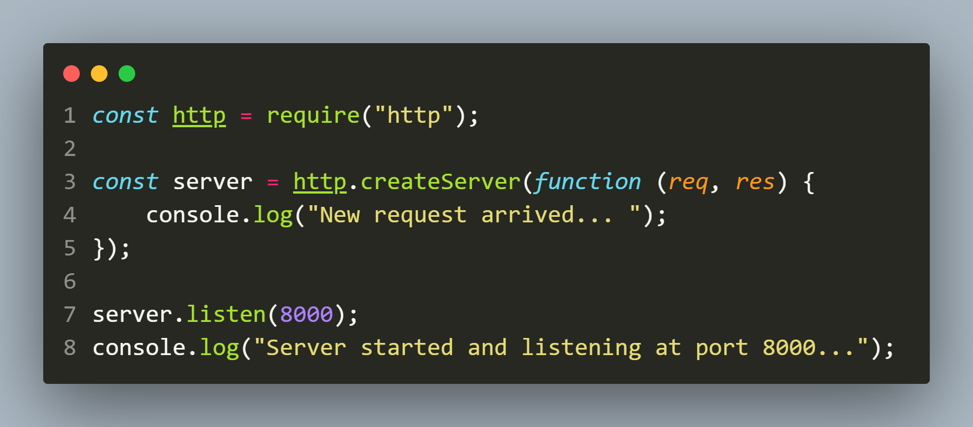
example
The code

Slide 13
A more professional way
A more professional way would be to create the callback function named on what it does.
For example, if we created a request listener function to return a list of books, we would likely name it listBooks() or listProducts() etc.
Since this one is a sample case, we will use the generic name requestListener.

Slide 14
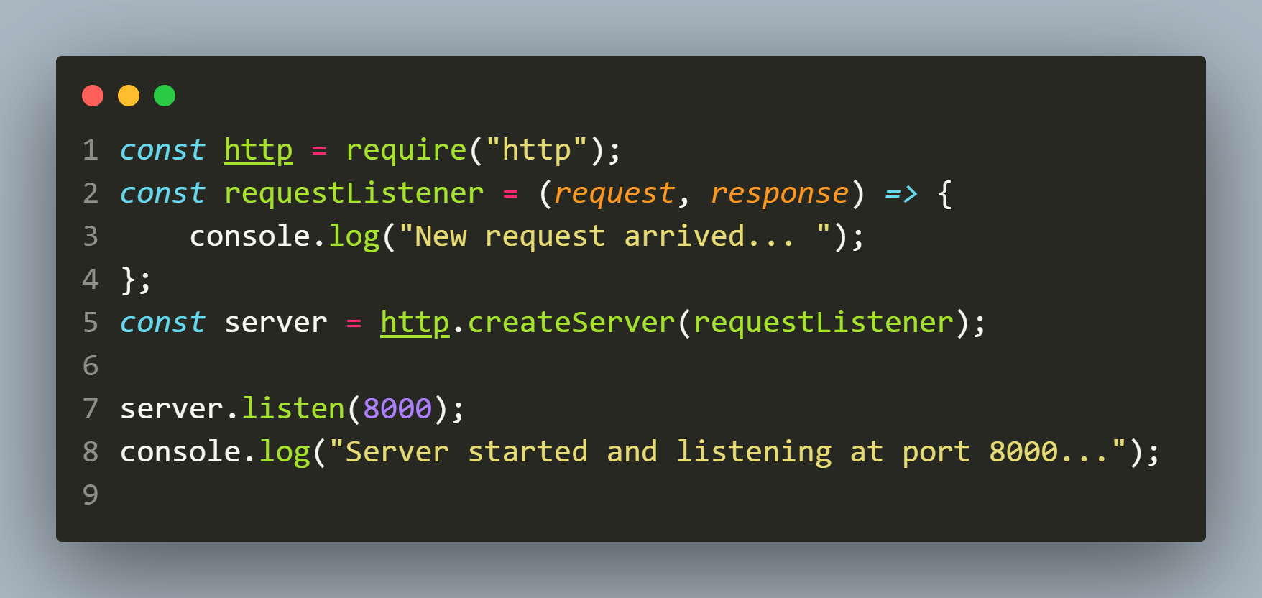
example
The code

Slide 15
Sending response
As mentioned before , all request listener functions in Node.js accept two arguments: request and response (we can name them differently if we want).
The HTTP request the user sends is captured in a Request object, which contains url ,data and many other details.
The HTTP response that we return to the user is formed by interacting with the Response object

Slide 16
Important methods of response object
Method or Property | Purpose
writeHead() | Sends status and response headers to the client
getHeader() | Returns the value of the specified header
headersSent | Returns true if headers were sent, otherwise false
removeHeader() | Removes the specified header
setHeader() | Sets the specified header
statusCode | Sets the status code that will be sent to the client
write() | Sends text, or a text stream, to the client
end() | Signals that the the server should consider that the response is complete

Slide 17
The writeHead() method
The response.writeHead() sends a response header corresponding to a request.
Syntax:
response.writeHead(statusCode[, headers]);
The status code is a 3-digit HTTP status code, like 404.
The last argument, headers, are the response headers

Slide 18
The write() method
The response.write() sends a chunk of response body for a request.
Syntax:
response.write(chunk [,encoding][,callback]);
chunk : It accepts any Buffer, or String Data.
Encoding : The default encoding set is ‘utf8‘. It accepts String Data.
callback : It accepts a callback function.

Slide 19
The end() method
The response.end() method is used to end the response process with or without data
Syntax:
response.end([data][,encoding][,callback]);
data : It accepts any Buffer, or String Data.
encoding : The default encoding set is ‘utf8‘. It accepts String Data.
callback : It accepts a callback function.

Slide 20
Exercise 33
WA Server to generate the message Hello from Node to the client on each request!

Slide 21
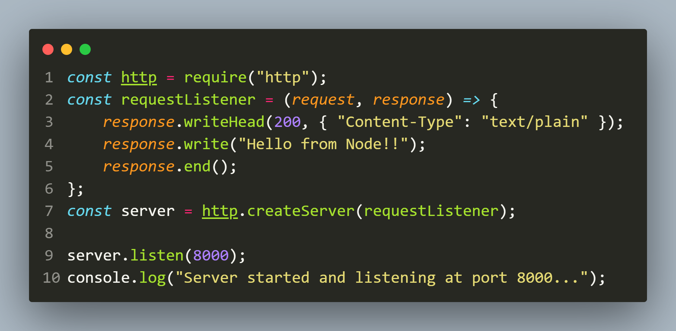
Solution 1
The code

Slide 22
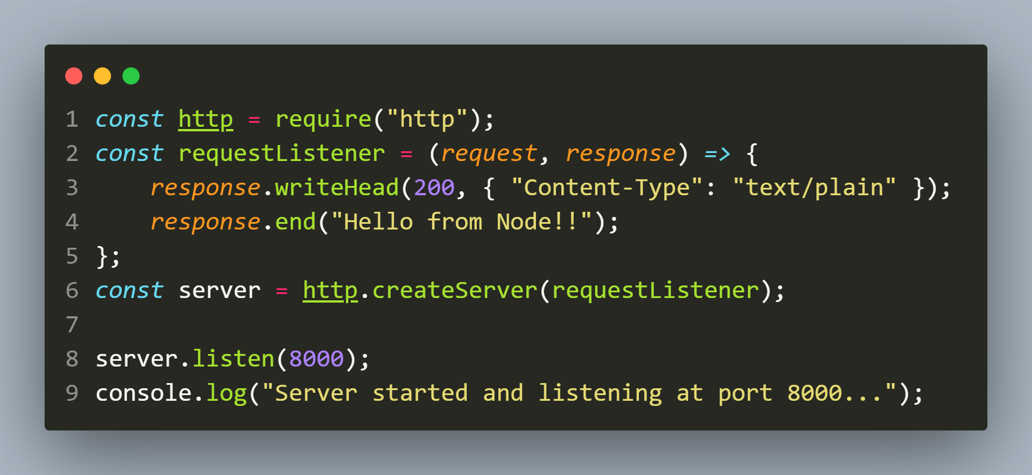
Solution 2
The code

Slide 23
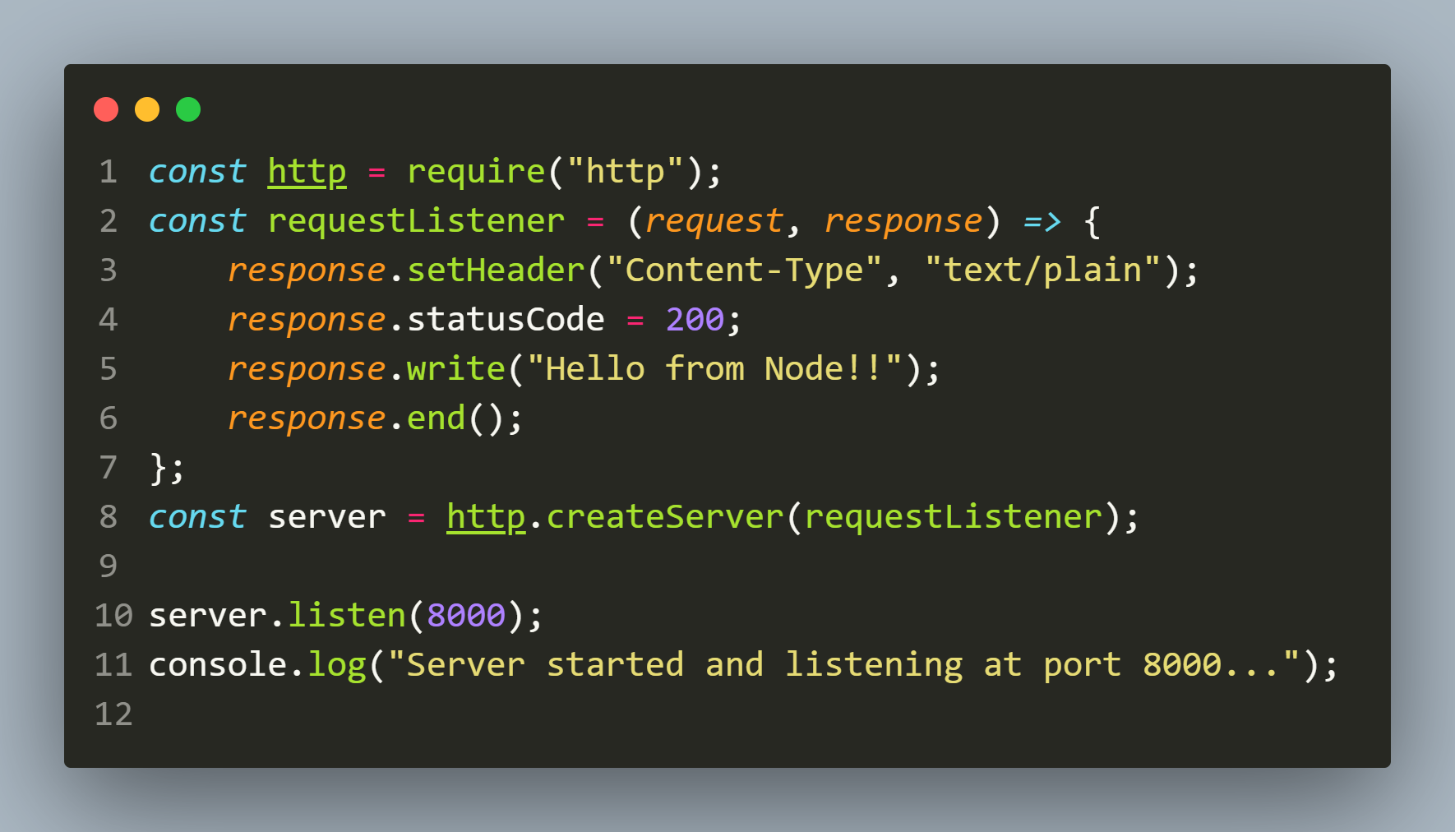
Solution 3
The code

Slide 24
Returning different types of content
In addition to the plain text we just returned, we can also return the following types of data:
JSON
CSV
HTML
These three data types are all text-based, and are popular formats for delivering content on the web.

Slide 25
Returning different types of content
In the context of Node.js, we need to do two things:
Set the Content-Type header in our HTTP responses with the appropriate value.
Ensure that write() or end() sends the data in the right format.

Slide 26
Returning html
In order to return HTML response we need to take 2 steps:
Set the Content-Type to text/html in writeHead() or setHeader()
Pass a valid HTML string as argument to write() or end()

Slide 27
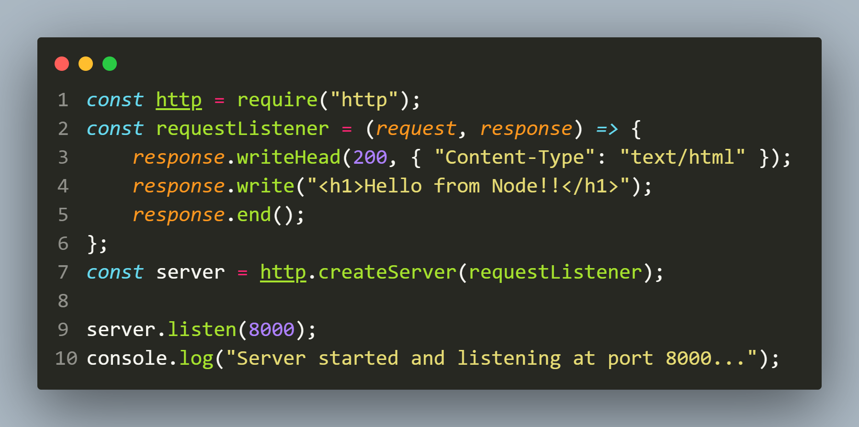
example
The code

Slide 28
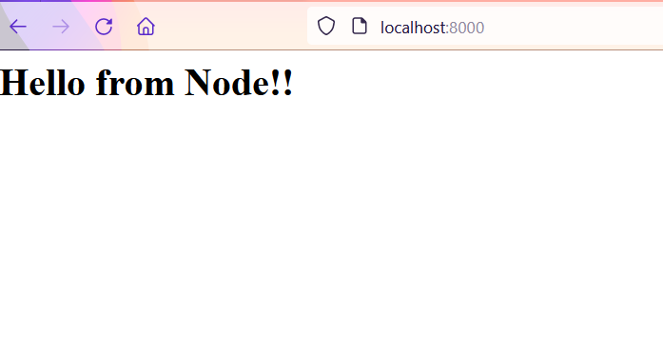
Output in browser
The output

Slide 29
Serving an html page from a file
We can serve HTML as strings in Node.js to the user, but it’s preferable that we load HTML files and serve their content.
This way, as the HTML file grows we don’t have to maintain long strings in our Node.js code, keeping it more concise and allowing us to work on each aspect of our website in an independent way.

Slide 30
Steps needed
Create an html file called index.html with some code in it
Import the “http” and “fs/promises” module
Create a request listener which does the following:
Opens and reads the file index.html
If the file is read properly then sets the Content-Type to text/html in writeHead() and status to 200
Passes the file data as argument to write() .
If an exception occurs , then sets the status to 500 and passes the error message to write()
Completes the response by calling end()
Create the server object by calling createServer()
Start the server by calling listen()

Slide 31
Exercise 34
WA Server to read and send the contents of the file index.html to the client on request!

Slide 32
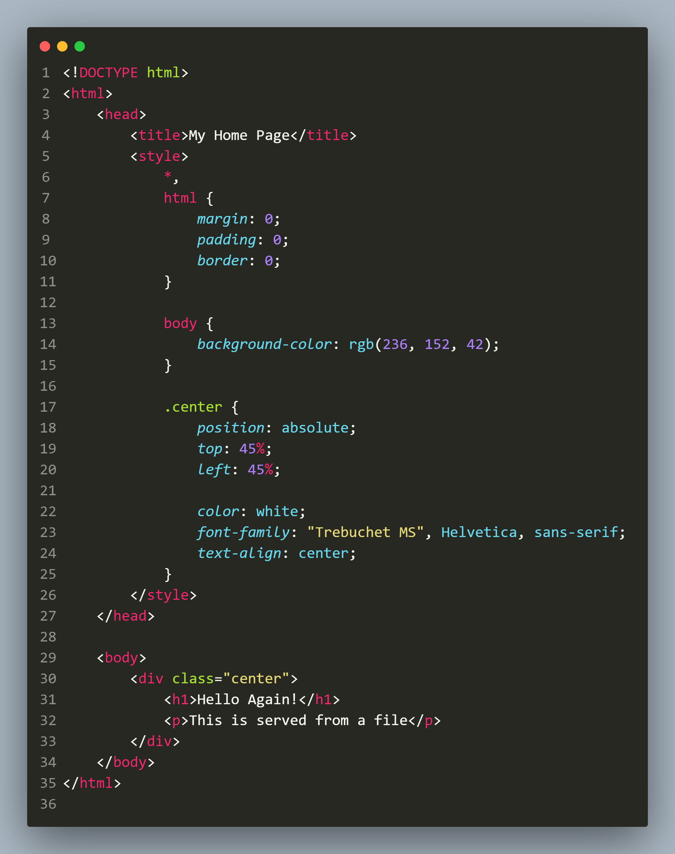
Solution: index.html
The code

Slide 33
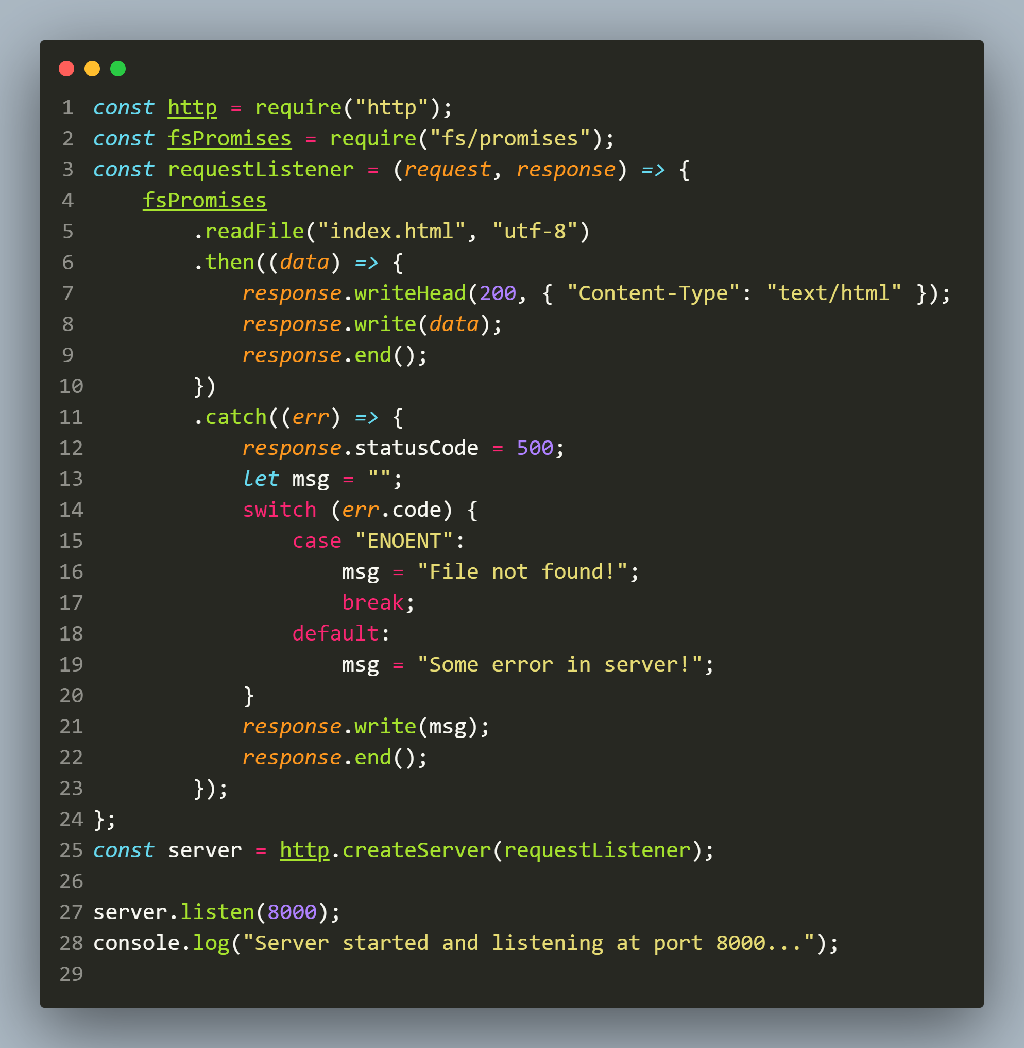
Solution: app.js
The code

Slide 34
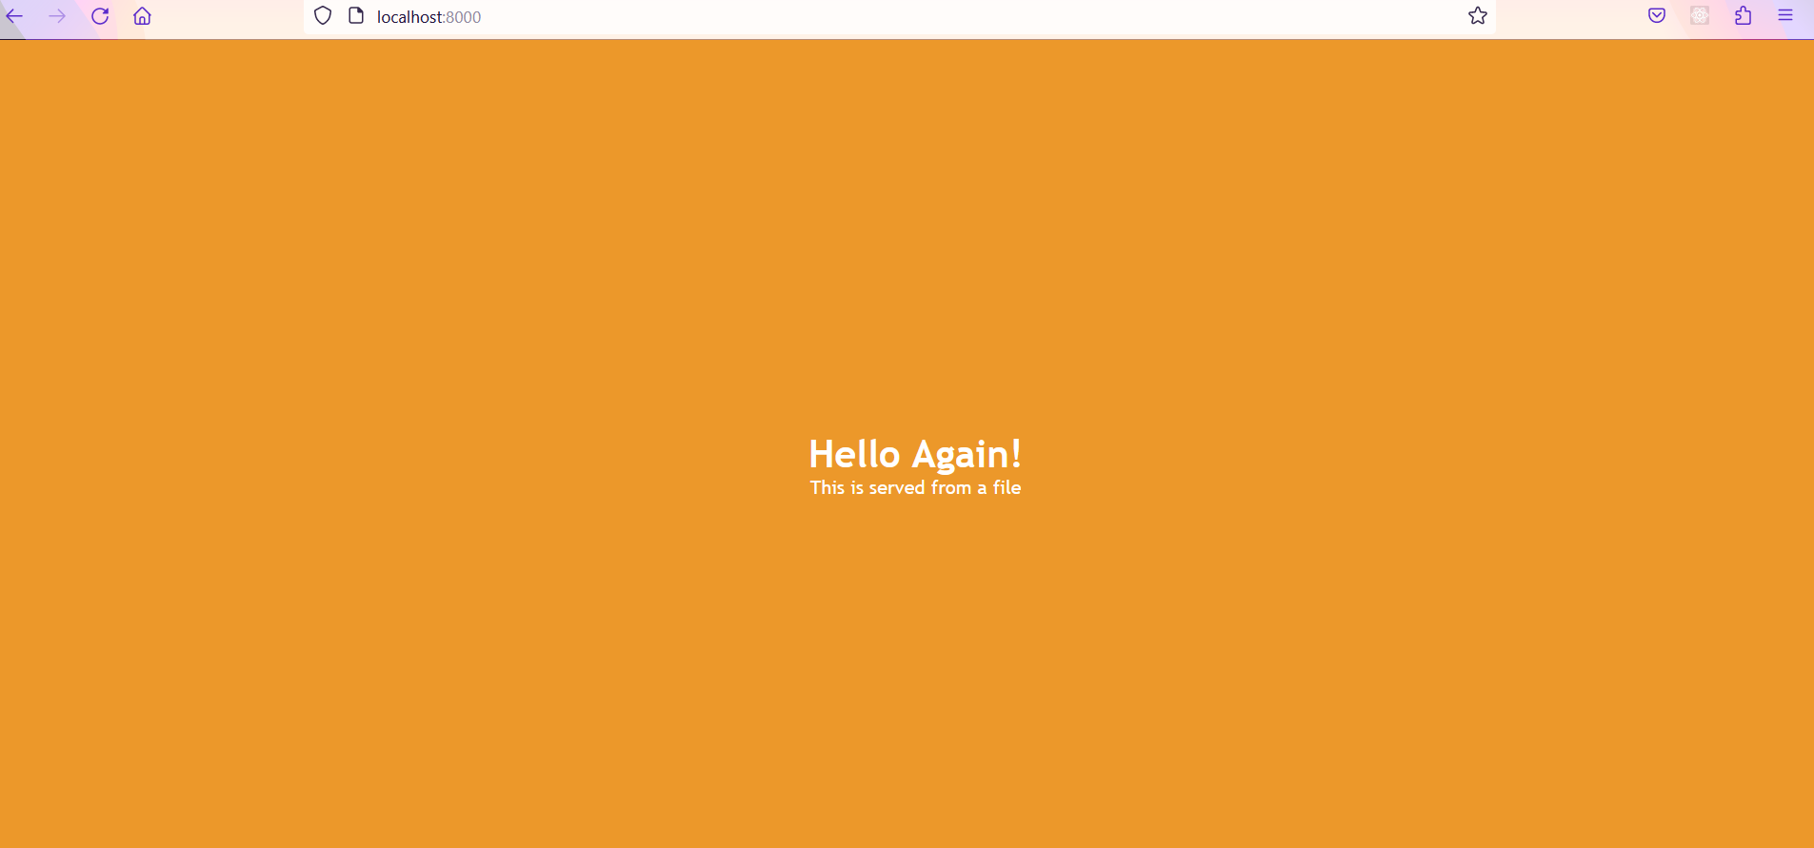
output
The output

Slide 35
Returning json
In order to return json response we need to take 2 steps:
Set the Content-Type to application/json in writeHead() or setHeader()
Pass a valid JSON string as argument to write() or end()

Slide 36
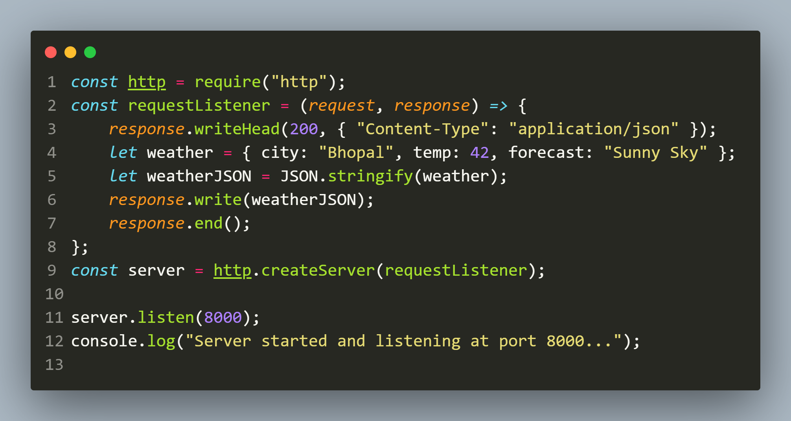
example
The code

Slide 37
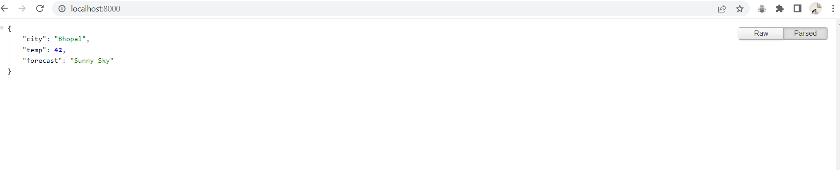
output
The output

Slide 38
Managing routes
Most websites we visit or APIs we use , usually have more than one endpoint so we can access various resources.
For example , in a library management app , we not only need to manage book data, but it would also manage author data for cataloguing and searching convenience.

Slide 39
Managing routes
Even though the data for books and authors are related, but they are two different objects.
In these cases, a backend developer will code each object on different endpoints as a way to indicate to the API user what kind of data they are interacting with.
And this is called Routing.

Slide 40
What is routing ?
So , Routing is a way for our application to determine how to respond to a requesting client.
This is done by simply matching the URL in the request object.

Slide 41
How to get the url ?
Each request object has a url property.
This property returns the url mentioned after the port no .
For example: If the requested url is localhost:8000/admin then request.url will return /admin

Slide 42
Exercise 35
Create a new server for a small library, which will return two different types of data.
If the user goes to localhost:8000/books, he should receive a list of books in JSON.
If he goes to localhost:8000/authors, he should receive a list of author information in JSON.
In any other case he should get the message resource not found

Slide 43
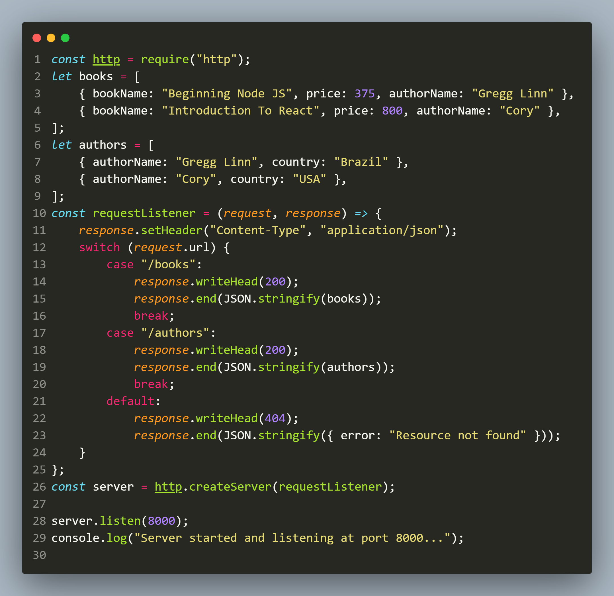
solution

Slide 44
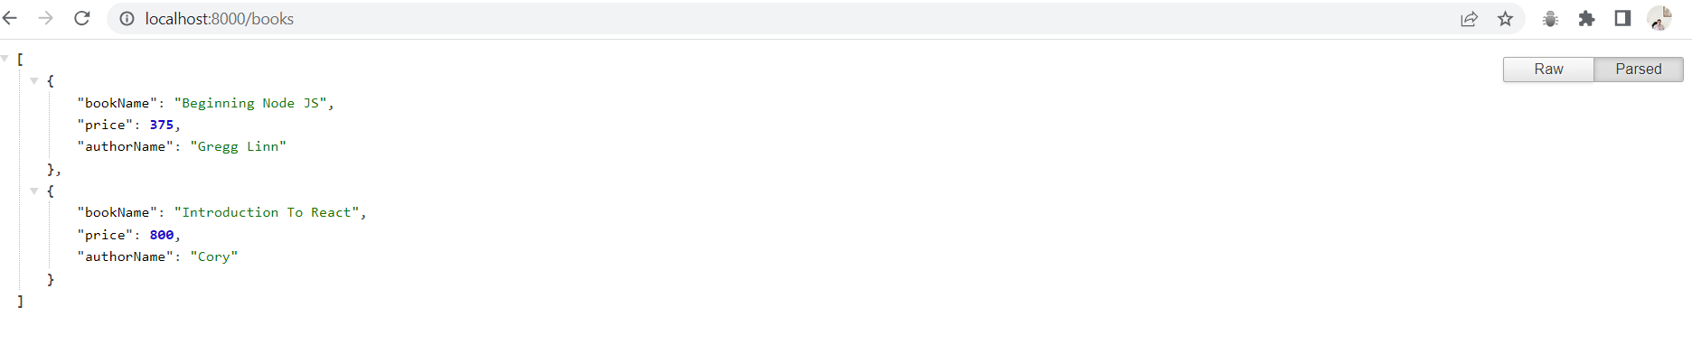
output

Slide 45
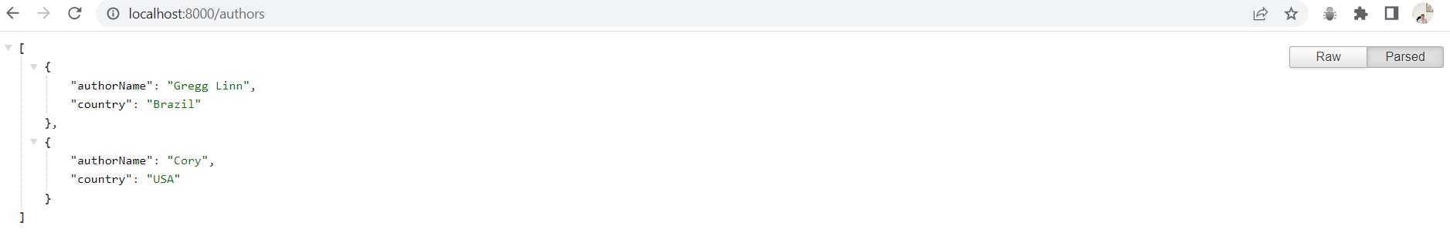
output

